Slide 1

Dimensioning and Optimization in Optical
Transport Networks
Master's degree in computer engineering and telematics
17th July 2018
Tiago Duarte Esteves
Supervisor: Prof. Armando Humberto Moreira Nolasco Pinto
Co-Supervisor: Dr. Rui Manuel Dias Morais
Notes:
orientador

Slide 2
Contents
Motivation
Network specification
Capital expenditures
Integer linear programming
Comparative analysis
Conclusions

Slide 3
Motivation
The crucial premise for network operators to choose the technology and architecture to deploy is cost minimization.
The tools used in transport network planning are the integer linear programming models, heuristic algorithms and analytical calculations for estimating results.
Notes:
A premissa crucial para as operadoras de rede escolherem a tecnologia e a arquitetura a serem implantadas é a minimização de custos.
As ferramentas utilizadas no planejamento da rede de transporte são os modelos inteiros de programação linear, algoritmos heurísticos e cálculos analíticos para estimar os resultados.
Será usado modelos de programação linear inteira pois tem a vantagem de obter a solução óptima, e permitem mudanças rápidas e fáceis. A sua principal desvantagem é o tempo de execução pois para redes mais complexas demora muito tempo.

Slide 4
Motivation
Network specification
Capital expenditures
Integer linear programming
Comparative analysis
Conclusions

Slide 5
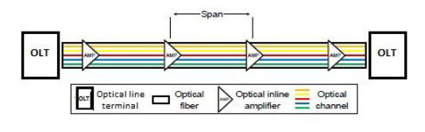
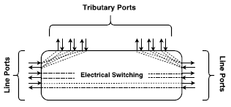
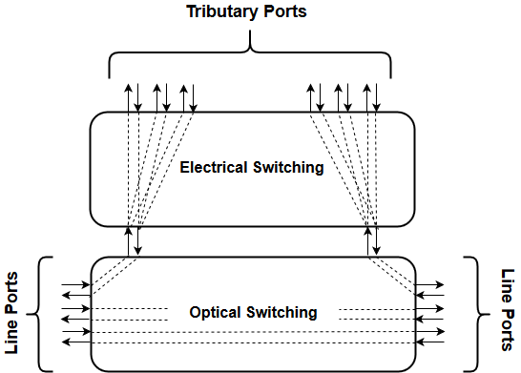
Network components
Link architecture
Node architecture
The links are physical point-to-point connections ensured by the transmission systems between two adjacent nodes. Each link has two optical line terminals, one at each end. The signals are transmitted through a pair of fibers with bidirectional communication. Contain optical amplifiers at an expected distance (span) to increase signal strength.
Notes:
Os links são conexões ponto-a-ponto físicas asseguradas pelos sistemas de transmissão entre dois nós adjacentes.
Cada link tem dois optical line terminal, um em cada extremidade.
Os sinais são transmitidos através de um par de fibras com comunicação bidirecional.
Contêm amplificadores ópticos a uma distância esperada (span) para aumentar a intensidade do sinal.

Slide 6
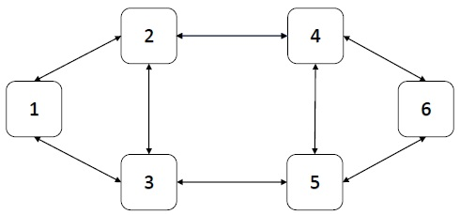
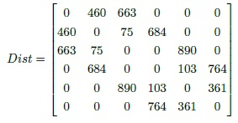
Reference network
In this specific case, the physical topology of the reference network consists of 6 nodes and 8 bidirectional links.
The distance matrix for this reference network is the same regardless of the associated traffic.
The values indicated in the matrix are expressed in kilometers (km) and this matrix is symmetric.

Slide 7
Traffic network
For this study three traffic scenarios for the reference network are created, being: low traffic, medium traffic and high traffic.
For each scenario different traffic matrices will be created where these matrices are represented taking into account the different bit rates ODU0, ODU1, ODU2, ODU3 and ODU4.
In each scenario it has a total bidirectional traffic, which is:
Low traffic scenario – 0,5 Tbits/s
Medium traffic scenario – 5 Tbits/s
High traffic scenario – 10 Tbits/s

Slide 8
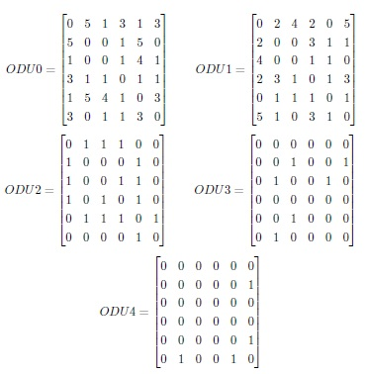
Low traffic – 0,5 Tbits/s

Slide 9
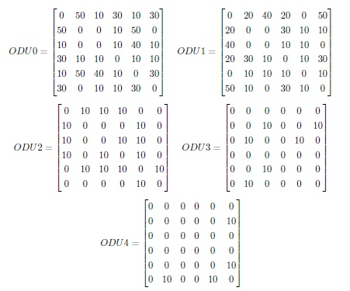
Medium traffic – 5 Tbits/s

Slide 10
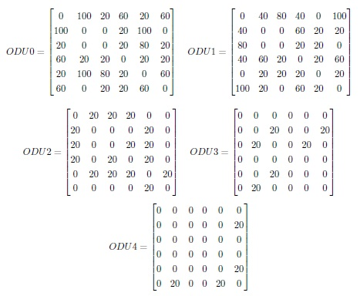
High traffic – 10 Tbits/s

Slide 11
Transport modes
Although the same physical links are always the same traffic is carried out differently.
Depending on the number of conversions of an optical signal to the electrical domain, different modes of transport will appear.
Opaque transport mode
Transparent transport mode
Translucent transport mode
Notes:
Embora sejam sempre os mesmos links físicos o tráfego é realizado de forma diferente. Dependendo do número de conversões de um sinal óptico para o domínio elétrico, diferentes modos de transporte aparecerão.

Slide 12
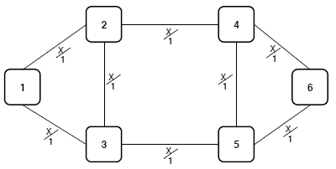
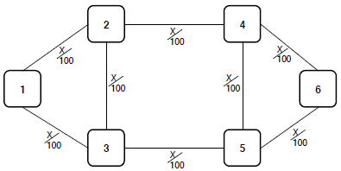
Opaque Transport mode
The opaque transport mode performs OEO conversions on each intermediate node because of the need for converting to electronic domain.
The optical and physical topologies are the same, causing each traffic route to match the link-to-link path imposed by fiber optics between each intermediate node to the destination.
Dimensioning and Optimization in Optical Transport Networks
Notes:
O modo de transporte opaco realiza conversões de OEO em cada nó intermediário devido à necessidade de conversão para domínio eletrônico. As topologias ótica e física são as mesmas, fazendo com que cada rota de tráfego corresponda ao caminho de link a link imposto por fibra ótica entre cada nó intermediário para o destino.

Slide 13
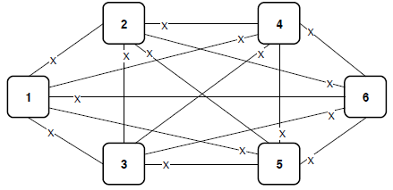
transparent Transport mode
In transparent transport mode, a route is only defined between source and destination nodes always in the optical domain.
In this mode the physical and optical topologies are different.
This type of network performs the OEO conversion only at the end nodes of the path.
Dimensioning and Optimization in Optical Transport Networks
Notes:
No modo de transporte transparente, uma rota é definida apenas entre nós de origem e destino sempre no domínio ótico.
Neste modo, as topologias físicas e ópticas são diferentes.
Esse tipo de rede realiza a conversão OEO apenas nos nós finais do caminho.

Slide 14
translucent Transport mode
This mode of transport is a combination of the other two transport modes taking the respective advantages of both.
The physical and optical topologies are different, the latter having several solutions.
The OEO conversion is done in some intermediate places before arriving at its destination.
Dimensioning and Optimization in Optical Transport Networks
Notes:
O modo de transporte translúcido é uma combinação dos outros dois modos de transporte, tendo as respectivas vantagens de ambos. As topologias físicas e ópticas são diferentes, tendo estas últimas várias soluções. A conversão OEO, neste caso, é feita em alguns lugares intermediários antes de chegar ao seu destino.

Slide 15
Motivation
Network specification
Capital expenditures
Integer linear programming
Comparative analysis
Conclusions

Slide 16




Capex using Ilp models
The telecommunications networks are formed by links and nodes, therefore, it is possible to define the CAPEX as the sum of the cost of the links and the cost of the nodes.
Link:
A link consists of two optical line terminals, has several amplifiers placed at a certain distance (span) and consists of several optical channels each with a certain wavelength.
The number of amplifiers for each link is obtained by the length of a link and the distance between amplifiers (span).
Node:
The nodes have an electrical part and an optical part so the cost of the nodes is given by the sum of these two parts.
The electric and optical cost is the sum of the fixed cost of the electrical/optical connection with the total cost of all respective ports.
Dimensioning and Optimization in Optical Transport Networks

Slide 17

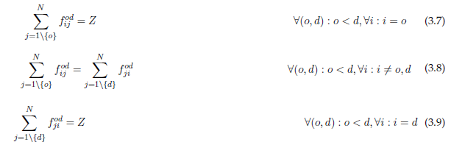
Capex using Ilp models
In this work we assume that the routing is performed by the ILP model instead of feeding it with candidate paths. The flow conservation constraints ensures that, for each (o,d) pair we route Z units of flow from node o to node d.
Dimensioning and Optimization in Optical Transport Networks
Notes:
Neste trabalho, assumimos que o roteamento é realizado pelo modelo ILP em vez de alimentá-lo com caminhos candidatos. As restrições de conservação de fluxo asseguram que, para cada par (o, d), roteamos unidades Z de fluxo do nó o para o nó d.

Slide 18






Capex – using Ilp models
Opaque mode:
Transparent mode:
Translucent mode:
Number of short-reach ports of the electrical switch with bit-rate c in node n i.e. number of tributary ports.
Number of long-reach ports of the electrical switch with bit-rate -1 in node n i.e. number of line ports.
In opaque mode there is no optical part so there are no optical switch ports.
Number of long-reach ports of the electrical switch with bit-rate -1 in node n i.e. number of add ports.
Number of long-reach ports of the optical switch in node n i.e. number of line ports and adding ports of node n.
Dimensioning and Optimization in Optical Transport Networks

Slide 19


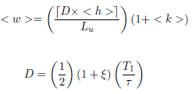

Capex – using analytical models
This time the calculations are made in an analytical way in order to get a different point of view and expected similar results.
Link:
The cost of the link is calculated through total values and assuming analytically calculated average values.
Node:
The cost of the nodes is calculated through the sum of electrical part and optical part.
The electric and optical cost is the total nodes times the fixed cost of the electrical/optical connection and the cost of average number of respective ports.
Dimensioning and Optimization in Optical Transport Networks

Slide 20





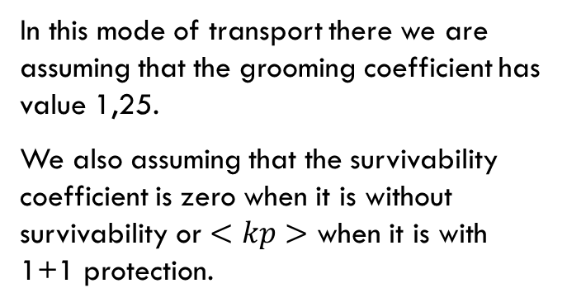
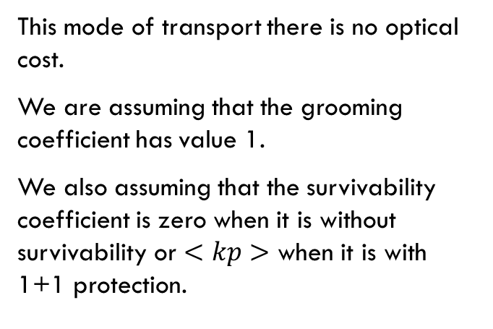
Capex – using analytical models
Opaque mode:
Transparent mode:
This mode of transport there is no optical cost.
We are assuming that the grooming coefficient has value 1.
We also assuming that the survivability coefficient is zero when it is without survivability or $<kp>$ when it is with 1+1 protection.
In this mode of transport there we are assuming that the grooming coefficient has value 1,25.
We also assuming that the survivability coefficient is zero when it is without survivability or $<kp>$ when it is with 1+1 protection.
Dimensioning and Optimization in Optical Transport Networks

Slide 21
Motivation
Network specification
Capital expenditures
Integer linear programming
Comparative analysis
Conclusions

Slide 22
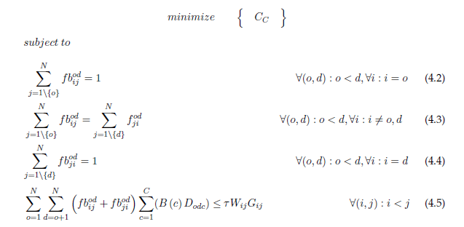
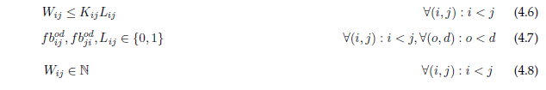
Ilp – Opaque without survivability
Dimensioning and Optimization in Optical Transport Networks

Slide 23
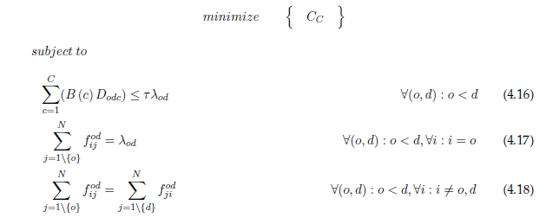
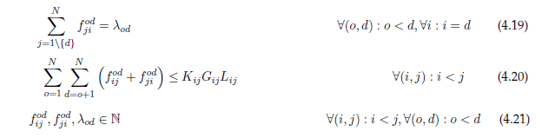
Ilp – transparent without survivability
Dimensioning and Optimization in Optical Transport Networks

Slide 24
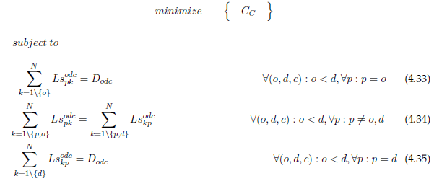
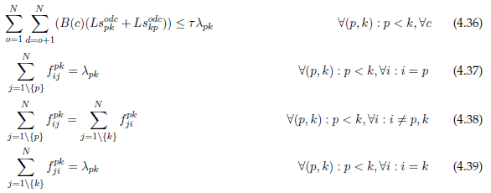
Ilp – translucent without survivability
Dimensioning and Optimization in Optical Transport Networks

Slide 25
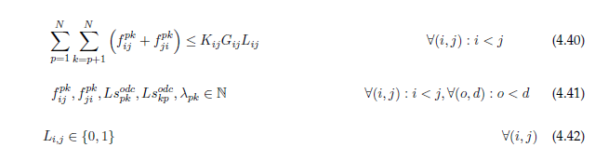
Ilp – translucent without survivability
Dimensioning and Optimization in Optical Transport Networks

Slide 26
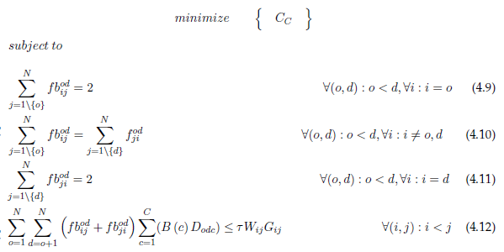

Ilp – Opaque with 1+1 protection
Dimensioning and Optimization in Optical Transport Networks

Slide 27
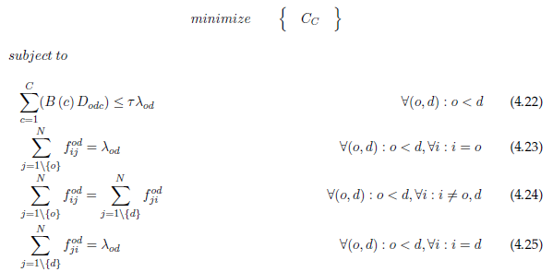
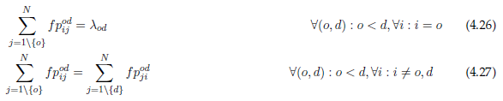
Ilp – transparent with 1+1protection
Dimensioning and Optimization in Optical Transport Networks

Slide 28
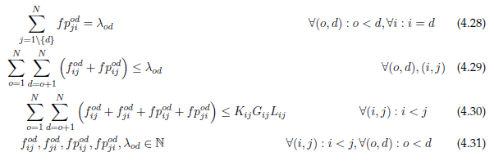
Ilp – transparent with 1+1protection
Dimensioning and Optimization in Optical Transport Networks

Slide 29
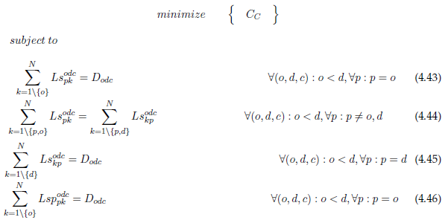
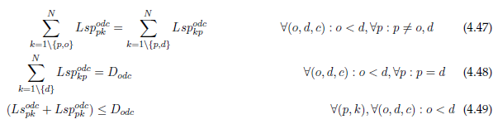
Ilp – translucent with 1+1 protection
Dimensioning and Optimization in Optical Transport Networks

Slide 30
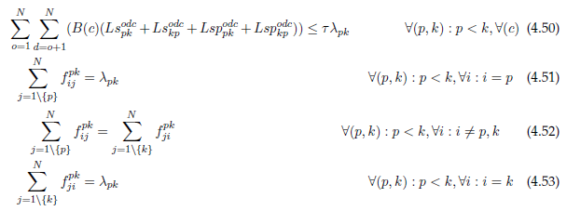
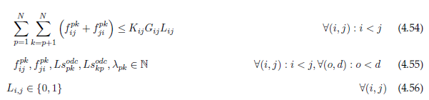
Ilp – translucent with 1+1 protection
Dimensioning and Optimization in Optical Transport Networks

Slide 31
Motivation
Network specification
Capital expenditures
Integer linear programming
Comparative analysis
Conclusions

Slide 32
Opaque transport mode
without survivability
 | ILP | Analytical | Heuristics
Low scenario | 11 266 590 € | 10 115 720 € (-10%) | 14 382 590 € (+28%)
Medium scenario | 90 605 900 € | 92 937 260 € (+3%) | 92 405 900 € (+2%)
High scenario | 178 231 800 € | 184 794 340 € (+4%) | 178 834 200 € (0%)
with 1+1 protection
 | ILP | Analytical | Heuristics
Low scenario | 26 982 590 € | 25 454 380 € (-6%) | 28 182 590 € (+4%)
Medium scenario | 239 405 900 € | 241 483 260 € (+1%) | 239 405 900 € (0%)
High scenario | 477 031 800 € | 481 107 780 € (+1%) | 477 034 200 € (0%)
Dimensioning and Optimization in Optical Transport Networks

Slide 33
transparent transport mode
without survivability
 | ILP | Analytical | Heuristics
Low scenario | 30 317 590 € | 10 827 792 € (-64%) | 30 317 590 € (0%)
Medium scenario | 96 830 900 € | 99 189 607 € (+2%) | 99 700 900 € (+3%)
High scenario | 180 471 800 € | 197 179 213 € (+9%) | 186 006 800 € (+3%)
with 1+1 protection
 | ILP | Analytical | Heuristics
Low scenario | 72 467 590 € | 25 449 133 € (-65%) | 72 527 590 € (0%)
Medium scenario | 239 540 900 €* | 239 061 736 € (0%) | 242 410 900 € (+1%)
High scenario | 448 806 800 €* | 476 119 473 € (+6%) | 454 341 800 € (+1%)
* It is not an optical solution. Best result after one week
Dimensioning and Optimization in Optical Transport Networks
Notes:
Dizer o que é o *

Slide 34
translucent transport mode
without survivability
 | ILP | Heuristics
Low scenario | 7 531 590 € | 11 592 590 € (+54%)
Medium scenario | 43 427 900 € | 49 125 900 € (+13%)
High scenario | 85 988 800 € | 93 921 800 € (+9%)
with 1+1 protection
 | ILP | Heuristics
Low scenario | 12 567 590 € | 29 682 590 € (+136%)
Medium scenario | 96 665 900 € | 99 375 900 € (+3%)
High scenario | 195 051 800 €* | 186 381 800 € (-4%)
* It is not an optical solution. Best result after one week
Dimensioning and Optimization in Optical Transport Networks
Notes:
Mais complexo de todos e muito trafego….

Slide 35
Motivation
Network specification
Capital expenditures
Integer linear programming
Comparative analysis
Conclusions

Slide 36
Cost per bit
without survivability
 | Low traffic scenario | Medium traffic scenario | High traffic scenario
Opaque | 22.533 €/Gbit/s | 18.121 €/Gbit/s | 17.823 €/Gbit/s
Transparent | 60.630 €/Gbit/s | 19.366 €/Gbit/s | 18.047 €/Gbit/s
Translucent | 15.063 €/Gbit/s | 8.685 €/Gbit/s | 8.599 €/Gbit/s
With 1+1 protection
 | Low traffic scenario | Medium traffic scenario | High traffic scenario
Opaque | 53.963 €/Gbit/s | 47.881 €/Gbit/s | 47.703 €/Gbit/s
Transparent | 144.935 €/Gbit/s | 47.908 €/Gbit/s | 44.880 €/Gbit/s
Translucent | 25.135 €/Gbit/s | 19.333 €/Gbit/s | 19.505 €/Gbit/s
Dimensioning and Optimization in Optical Transport Networks

Slide 37
Conclusions
ILP models have been developed for all transport modes without survivability and with 1+1 protection where each model contains a set of constraints.
For a comparative analysis is used the network CAPEX analytically calculated and the results obtained with the heuristic algorithms already created.
From the analytical model we can state, taking into account the margin of error of 10%, that all formulas and deductions for the opaque and transparent mode give us a value close to the optimum.
Dimensioning and Optimization in Optical Transport Networks
Notes:
Os modelos ILP foram desenvolvidos para todos os modos de transporte sem capacidade de sobrevivência e com proteção 1 + 1, onde cada modelo contém um conjunto de restrições. Para uma análise comparativa é utilizado o CAPEX de rede calculado analiticamente e os resultados obtidos com os algoritmos heurísticos já criados. A partir do modelo analítico podemos afirmar, levando em conta a margem de erro de 10%, que todas as fórmulas e deduções para o modo opaco e transparente nos dão um valor próximo ao ótimo.

Slide 38
Conclusions
The heuristic algorithms are a good solution for realistic and more complex networks because it obtains results close to the optimal solutions obtained by the ILPs.
We can say that the best ILP model is the translucent mode, because it provides a lower cost than the other modes allowing to carry more traffic.
Regardless of the model chosen, it is always more advantageous to put high traffic on the network.
Dimensioning and Optimization in Optical Transport Networks
Notes:
Os algoritmos heurísticos são uma boa solução para redes realistas e mais complexas, pois obtêm resultados próximos das soluções ótimas obtidas pelas ILPs. Podemos dizer que o melhor modelo de ILP é o modo translúcido, pois proporciona um custo menor do que os outros modos permitindo transportar mais tráfego. Independentemente do modelo escolhido, é sempre mais vantajoso colocar alto tráfego na rede.

Slide 39
Thank you!

